Slide 1
Department of CSE
COURSE NAME: DATA SCIENCE AND VISUALIZATION
COURSE CODE: 22AD3206R
Topic: Measures of Variation
Session - 10

Slide 2



AIM OF THE SESSION
To familiarize students with the basic concept of Measure of variability
INSTRUCTIONAL OBJECTIVES
This Session is designed to:
To determine the reliability of an average by pointing out as how far an average is representative of the entire data.
Enable comparison of two or more distribution with regard to their variability
Measuring variability is of great importance to other statistical analysis..
LEARNING OUTCOMES
At the end of this session, you should be able to:
Define Measure of variability
Describe different types of Measure of Variability
Summarize importance of measure of variability in statistical analysis for solving realworld problems.

Slide 3
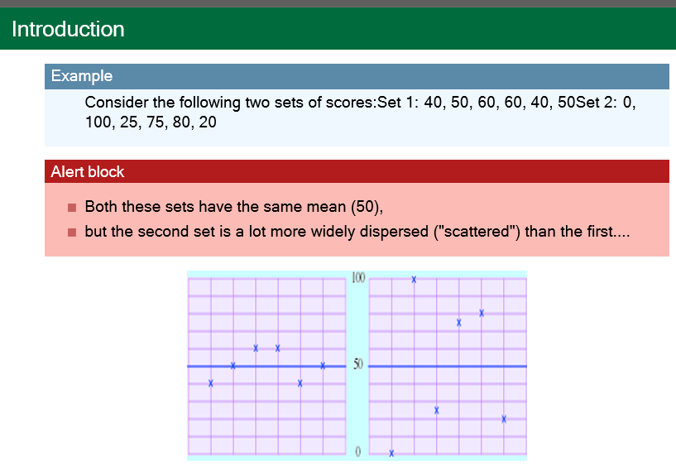
3. MEASURE OF VARIATION
Measure of Variation

Slide 4
Measure of variation/dispersion
The scatter or spread of items of a distribution is known as dispersion or variation.
In other words the degree to which numerical data tend to spread about an average value is called dispersion or variation of the data.
Measures of dispersion are statistical measures which provide ways of measuring the extent in which data are dispersed or spread out.

Slide 5
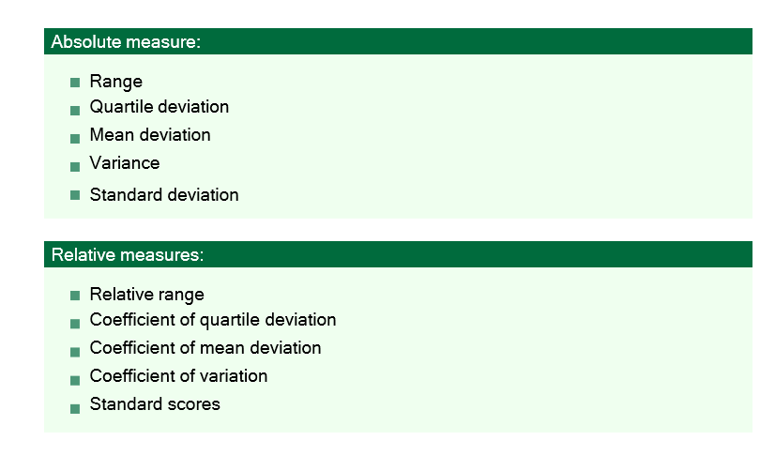
TYPES OF MEASURE OF VARIATION

Slide 6
1. ABSOLUTE MEASURE
A. THE RANGE
Range:
The range is the simplest measure of variation and is calculated as the difference between the maximum and minimum values in a dataset. It provides a basic understanding of how spread out the data is.
The formula for calculating the range of a dataset is straightforward:
Range = Maximum Value - Minimum Value
To find the range of a dataset, follow these steps:
Identify the maximum value (the largest value) in the dataset.
Identify the minimum value (the smallest value) in the dataset.
Subtract the minimum value from the maximum value to find the range.

Slide 7
EXAMPLE
Example
Example, if you have a dataset of exam scores:
Scores: 78, 85, 92, 64, 97
To calculate the range, you would:
Identify the maximum value: Max Value = 97
Identify the minimum value: Min Value = 64
Calculate the range: Range = 97 - 64 = 33
So, in this case, the range of the exam scores is 33.

Slide 8
b. QUARTILE DEVIATION
Quartile Deviation:
Quartile deviation, also known as the semi-interquartile range, is a measure of statistical dispersion or variability in a dataset. It is closely related to quartiles and the interquartile range (IQR). The quartile deviation quantifies the spread of data points around the median by considering the middle 50% of the data.
Here's how you can calculate the quartile deviation:
Calculate the first quartile (Q1) and the third quartile (Q3) of the dataset.
Q1 is the 25th percentile, and Q3 is the 75th percentile.
Find the interquartile range (IQR) by subtracting Q1 from Q3: IQR = Q3 - Q1
Calculate the quartile deviation by dividing the IQR by 2:
Quartile Deviation = (Q3 - Q1) / 2

Slide 9
EXAMPLE
Let's illustrate the calculation of quartile deviation with a simple example. Suppose we have a dataset of exam scores for a group of students:
Exam Scores: 75, 82, 88, 92, 96, 100, 105, 110
1. Calculate the first quartile (Q1) and the third quartile (Q3) for the dataset:
Q1 (25th percentile) = 82
Q3 (75th percentile) = 105
2. Find the interquartile range (IQR) by subtracting Q1 from Q3:
IQR = Q3 - Q1
IQR = 105 - 82
IQR = 23
3. Calculate the quartile deviation by dividing the IQR by 2:
Quartile Deviation = IQR / 2
Quartile Deviation = 23 / 2
Quartile Deviation = 11.5

Slide 10
c. MEAN DEVIATION
Mean Deviation: Mean Deviation, also known as the Average Deviation, is a measure of statistical dispersion or variability in a dataset. It quantifies the average absolute difference between each data point in the dataset and the mean (average) of the dataset.
Mean Deviation provides insights into how much individual data points deviate from the central tendency (mean) and gives an indication of the overall spread or dispersion of the data.
The formula for calculating Mean Deviation for a dataset with 'n' data points is as follows:
Mean Deviation = Σ |X - μ| / n
Where:
Σ represents the summation symbol, meaning you should sum up the values for all data points.
|X - μ| represents the absolute difference between each data point 'X' and the mean 'μ'.
'n' is the total number of data points in the dataset .

Slide 11
SESSION DESCRIPTION (Cont..)
How to calculate :
Calculate the mean (average) of the dataset.
For each data point, find the absolute difference between that data point and the mean.
Sum up all these absolute differences.
Divide the sum by the total number of data points 'n' to get the Mean Deviation.

Slide 12
EXAMPLE
Let's calculate the Mean Deviation for a small dataset to illustrate how it works. Suppose we have a dataset of test scores for a group of students: Test Scores: 85, 92, 88, 76, 90
Calculate the mean (average) of the dataset:
Mean (μ) = (85 + 92 + 88 + 76 + 90) / 5 = 88.2
Find the absolute difference between each data point and the mean:
|85 - 88.2| = 3.2
|92 - 88.2| = 3.8
|88 - 88.2| = 0.2
|76 - 88.2| = 12.2
|90 - 88.2| = 1.8
Sum up all these absolute differences:
Σ |X - μ| = 3.2 + 3.8 + 0.2 + 12.2 + 1.8 = 21.2
Divide the sum by the total number of data points 'n' (which is 5 in this case):
Mean Deviation = Σ |X - μ| / n = 21.2 / 5 = 4.24

Slide 13
d. VARIANCE

Slide 14
SESSION DESCRIPTION (Cont..)
Variance :
To calculate the variance:
Calculate the mean (average) of the dataset.
For each data point, find the squared difference between that data point and the mean.
Sum up all these squared differences.
Divide the sum by the total number of data points 'n' to get the variance.

Slide 15
SESSION DESCRIPTION (Cont..)
Variance :
To calculate the variance:
Calculate the mean (average) of the dataset.
For each data point, find the squared difference between that data point and the mean.
Sum up all these squared differences.
Divide the sum by the total number of data points 'n' to get the variance.

Slide 16
e. STANDARD DEVIATION
Standard deviation is a widely used statistical measure of the amount of variation or dispersion in a dataset. It quantifies how individual data points deviate from the mean (average) of the dataset. Standard deviation is a more interpretable measure than variance because it's in the same unit as the original data, unlike the squared unit of variance.
The standard deviation (σ) is calculated using the following formula for a dataset with 'n' data points:
Standard Deviation (σ) = √[Σ (X - μ)² / n]
Where:
√ represents the square root.
Σ represents the summation symbol, meaning you should sum up the values for all data points.
(X - μ) represents the difference between each data point 'X' and the mean 'μ'.
(X - μ)² represents the squared difference between each data point and the mean.
'n' is the total number of data points in the dataset.

Slide 17
TO CALCULATE THE STANDARD DEVIATION

Slide 18
2. Relative measure a. Relative range
Relative range" doesn't have a standard or widely recognized definition in statistics or mathematics. It's possible that the term may be used in a specific context or industry where it has a specialized meaning, but without more information or context, it's challenging to provide examples or explanations related to "relative range.

Slide 19
b. Coefficient of Quartile Deviation (CQD)
The "Coefficient of Quartile Deviation" (CQD), also known as the "Quartile Deviation Coefficient," is a statistical measure that represents the relative variability or dispersion of a dataset in terms of its interquartile range (IQR).
It is a dimensionless measure, often expressed as a percentage, that allows for the comparison of the spread of data between different datasets, even if they have different units or scales.
The formula for calculating the Coefficient of Quartile Deviation (CQD) is as follows:
CQD = (IQR / Median) * 100

Slide 20
SESSION DESCRIPTION (Cont..)
The "Coefficient of Quartile Deviation" (CQD),
Where:
CQD is the Coefficient of Quartile Deviation.
IQR is the Interquartile Range, which is the range between the first quartile (Q1) and the third quartile (Q3) of the dataset.
Median is the middle value of the dataset.

Slide 21
SESSION DESCRIPTION (Cont..)
The "Coefficient of Quartile Deviation" (CQD),
To calculate the CQD:
Calculate the interquartile range (IQR) by subtracting the first quartile (Q1) from the third quartile (Q3):
IQR = Q3 - Q1
Calculate the median, which is the middle value of the dataset.
Divide the IQR by the median.
Multiply the result by 100 to express the CQD as a percentage.
The Coefficient of Quartile Deviation is useful for comparing the relative spread or variability of datasets with different central tendencies and scales. A smaller CQD indicates that the data is relatively more consistent and less variable, while a larger CQD indicates greater variability within the middle 50% of the dataset. It is a robust measure of variation that is less influenced by outliers compared to other measures like the coefficient of variation (CV), which uses the mean instead of the median.

Slide 22
c. Coefficient of Mean Deviation(CMD)
The "Coefficient of Mean Deviation" (CMD), also known as the "Mean Deviation Coefficient," is a statistical measure used to express the relative variability or dispersion of a dataset in terms of its mean deviation. The mean deviation is a measure of how data points in a dataset deviate from the mean (average) of the dataset.
The formula for calculating the Coefficient of Mean Deviation (CMD) is as follows:
CMD = (Mean Deviation / Mean) * 100
Where:
CMD is the Coefficient of Mean Deviation.
Mean Deviation is the average absolute difference between each data point in the dataset and the mean.
Mean is the average value of the dataset.

Slide 23
SESSION DESCRIPTION (Cont..)
The "Coefficient of Mean Deviation" (CMD)
To calculate the CMD:
Calculate the Mean Deviation. It's the average of the absolute differences between each data point and the mean.
Calculate the Mean, which is the average value of the dataset.
Divide the Mean Deviation by the Mean.
Multiply the result by 100 to express the CMD as a percentage.
The Coefficient of Mean Deviation allows for the comparison of the relative spread or variability of datasets with different central tendencies and scales. A smaller CMD indicates that the data is relatively more consistent and less variable around the mean, while a larger CMD suggests greater variability. It is a measure that provides information about the distribution and dispersion of data in relation to the mean.

Slide 24
d. Coefficient of Variation
The "Coefficient of Variation" (CV), also known as the "Relative Standard Deviation," is a statistical measure that expresses the relative variability or dispersion of a dataset as a ratio or percentage of the standard deviation to the mean (average). It is a dimensionless measure that allows for the comparison of the spread of data between different datasets, even if they have different units or scales.
The formula for calculating the Coefficient of Variation (CV) is as follows:
CV = (Standard Deviation / Mean) * 100
Where:
CV is the Coefficient of Variation.
Standard Deviation is a measure of the spread or dispersion of the data.
Mean is the average value of the dataset.

Slide 25
SESSION DESCRIPTION (Cont..)
To calculate the CV:
Calculate the Standard Deviation, which quantifies how data points deviate from the mean.
Calculate the Mean, which is the average value of the dataset.
Divide the Standard Deviation by the Mean.
Multiply the result by 100 to express the CV as a percentage.
The Coefficient of Variation is particularly useful for comparing the relative variability of datasets with different central tendencies and scales. A smaller CV indicates that the data is relatively more consistent and less variable around the mean, while a larger CV suggests greater relative variability.

Slide 26
SESSION DESCRIPTION (Cont..)
To calculate the CV:
Calculate the Standard Deviation, which quantifies how data points deviate from the mean.
Calculate the Mean, which is the average value of the dataset.
Divide the Standard Deviation by the Mean.
Multiply the result by 100 to express the CV as a percentage.
The Coefficient of Variation is particularly useful for comparing the relative variability of datasets with different central tendencies and scales. A smaller CV indicates that the data is relatively more consistent and less variable around the mean, while a larger CV suggests greater relative variability.

Slide 27

e. Standard scores
Standard scores, also known as z-scores or standardized values, are a way to measure how many standard deviations a particular data point is from the mean (average) of a dataset. They are used to standardize data, making it easier to compare and analyze values from different datasets or to identify outliers within a dataset.
The formula to calculate a standard score (z-score) for a data point 'X' in a dataset is as follows:

Slide 28
SELF-ASSESSMENT QUESTIONS
Which measure of variation is most affected by outliers in a dataset?_________
Range
Variance
Standard Deviation
Interquartile Range (IQR)
A small standard deviation indicates:____________
High data variability
Low data variability
perfectly symmetrical dataset
No variation in the data

Slide 29
TERMINAL QUESTIONS
What are measures of variation in statistics, and why are they important in data analysis? Provide examples of situations where understanding variation is crucial.
Explain the concept of range as a measure of variation. How is it calculated, and what are its limitations in characterizing the variability in a dataset? Provide a real-world example to illustrate.
Variance and standard deviation are commonly used measures of variation. Describe the differences between these two measures and discuss the advantages of using one over the other in specific analytical scenarios.
Discuss the coefficient of variation (CV) as a relative measure of variation. How is it computed, and why is it particularly useful when comparing datasets with different scales or units of measurement?

Slide 30
REFERENCES FOR FURTHER LEARNING OF THE SESSION
Reference Books:
References of Books:
Fry, Visualizing Data. O’Reilly Media, 2008, ISBN 0596514557.
Munzner, Visualization Analysis and Design, 2014, ISBN 1466508914
Ware, Information Visualization: Perception for Design, 3rd ed. Morgan Kaufmann, 2012, ISBN 0123814642.
Reference Books:
Paulraj Ponniah, “DATA MODELING FUNDAMENTALS”, A Practical Guide for IT Professionals.
Stephen Few, "Information dashboard design: The effective visual communication of data", O'Reilly,2006.
17. Keywords
Data Modeling, Data Abstraction, Visual encoding, Filtering and aggregation, Spatial

Slide 31

THANK YOU
Team – DSV

Slide 32
Department of CSE
COURSE NAME: DAV
COURSE CODE: 22CS2227
TOPIC :
Quartiles and Percentiles
Session - 11

Slide 33
AIM OF THE SESSION
To familiarize students with the basic concept of Measure of variability
INSTRUCTIONAL OBJECTIVES
This Session is designed to:
Understand the concept of quartiles and percentiles in statistics..
Learn how to calculate quartiles and percentiles.
Explore the applications of quartiles and percentiles in data analysis.
LEARNING OUTCOMES
At the end of this session, you should be able to:
should have a strong understanding of the concepts of quartiles and percentiles, and be able to calculate them accurately.
Develop the skills necessary to use quartiles and percentiles as tools for data analysis
Able to apply your knowledge in various real-world scenarios

Slide 34
SESSION INTRODUCTION
DEFINE QUARTILE?
“Quartiles in statistics are values that divide your data into
quarters”. However, quartiles aren’t shaped like pizza slices; Instead
they divide your data into four segments according to where the
numbers fall on the number line. The four quarters that divide a data
set into quartiles are:
The lowest 25% of numbers.
The next lowest 25% of numbers (up to the median).
The second highest 25% of numbers (above the median).
The highest 25% of numbers.

Slide 35
SESSION DESCRIPTION
.
USES OF QUARTILES
Quartiles are used to summarize a group of numbers.
• Instead of looking a big list of numbers(we look at just few numbers that gives us a picture of whats going on in the big list).
• Are great for reporting on a set of data and for making box and whisker plots.
• Especially useful when you’re working with data that is not symmetrically distributed or a data set that has outliers.
• Quartile summary is also play an important role in benchmarkingre of variation/dispersion

Slide 36
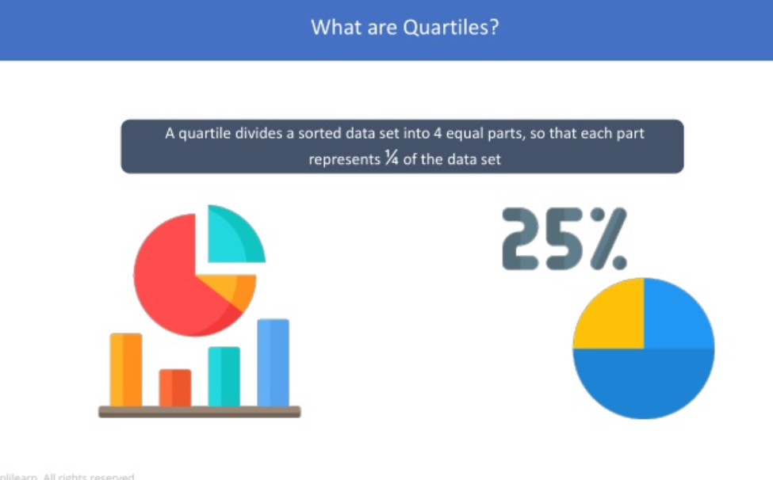
SESSION DESCRIPTION (Cont..)

Slide 37
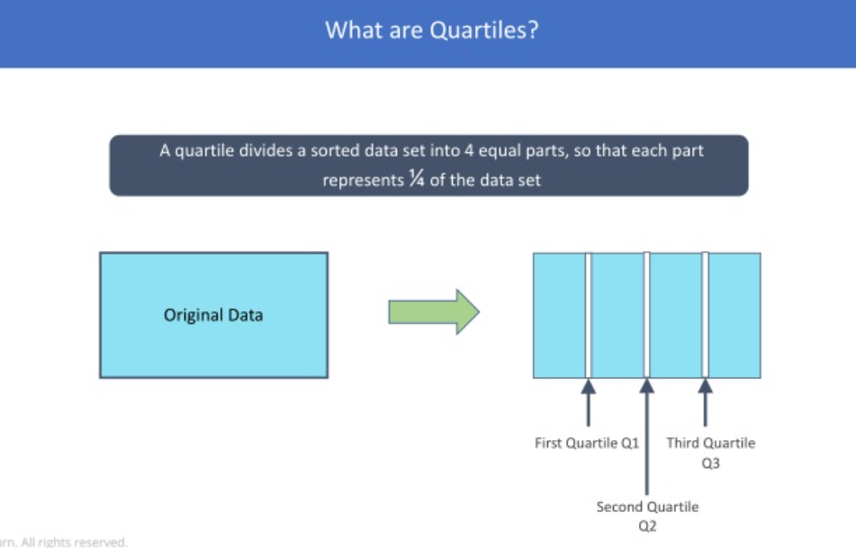
SESSION DESCRIPTION (Cont..)

Slide 38
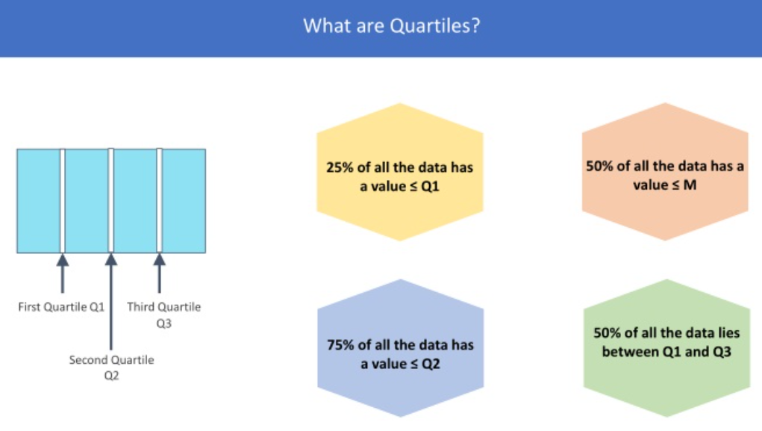
SESSION DESCRIPTION (Cont..)

Slide 39
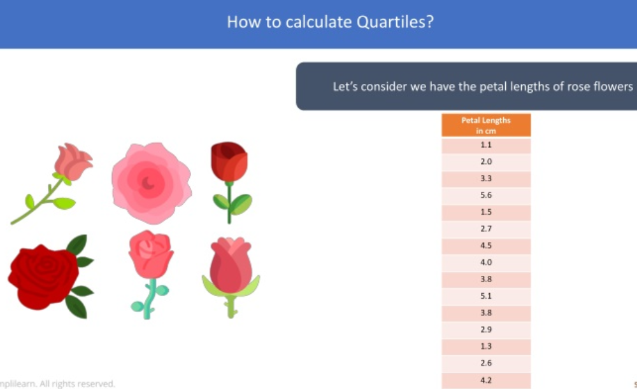
SESSION DESCRIPTION (Cont..)

Slide 40
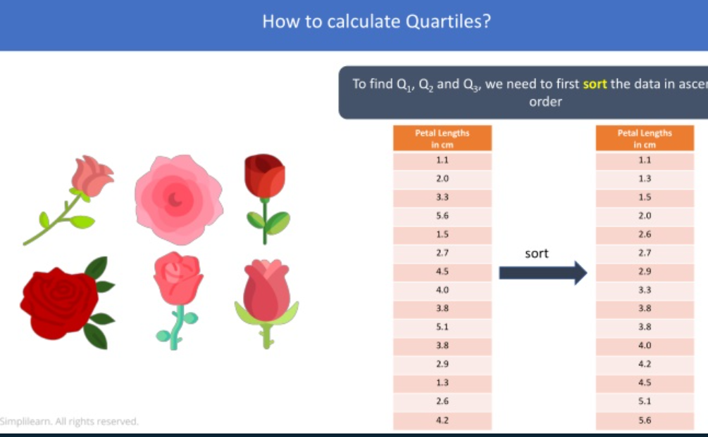
SESSION DESCRIPTION (Cont..)

Slide 41
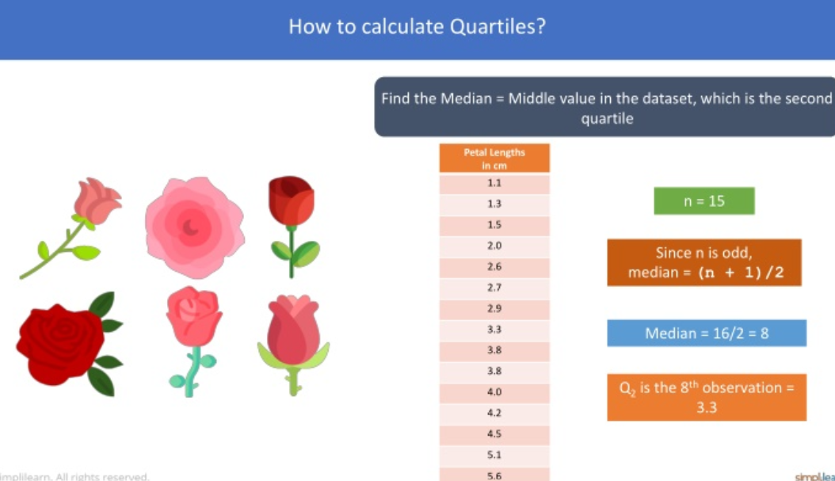
SESSION DESCRIPTION (Cont..)

Slide 42
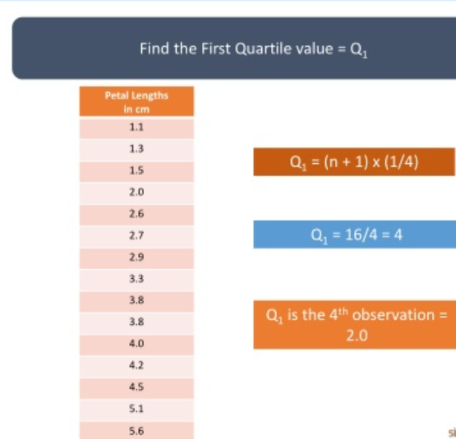
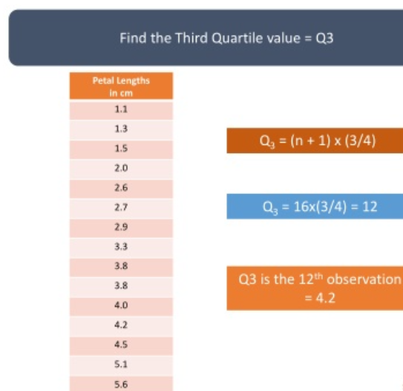
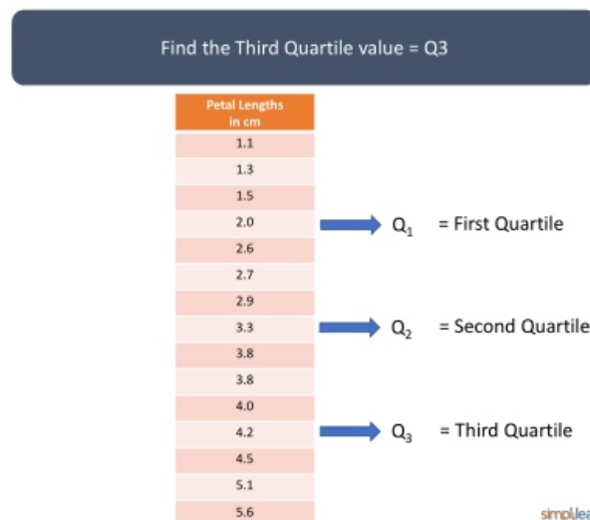
SESSION DESCRIPTION (Cont..)

Slide 43
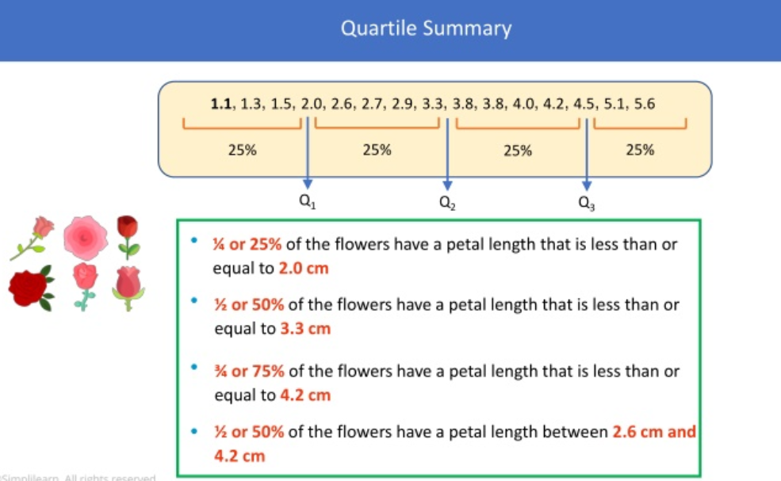
SESSION DESCRIPTION (Cont..)

Slide 44
SESSION DESCRIPTION (Cont..)
What is percentile
A percentile (or a centile) is a measure used in statistics indicating the value below which a given percentage of observations in a group of observations falls.
USES OF PERCENTILES:
PERCENTILES are used to understand and interpret data. They
indicate the values below which a certain percentage of the
data in a data set is found.
• Percentiles are frequently used to understand test scores and
biometric measurements.
• Percentiles are used extensively to report scores in academic
exams and tests such as GAT,NTS etc.

Slide 45
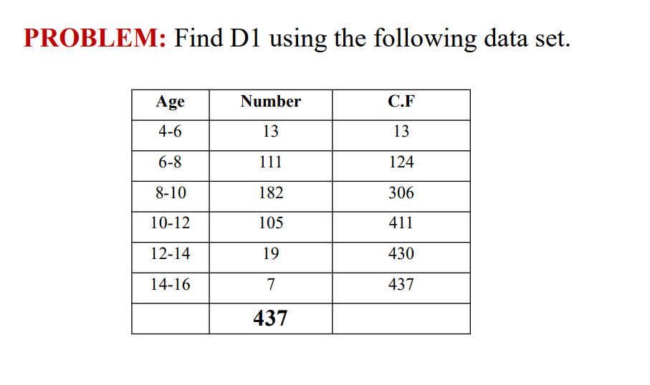
SESSION DESCRIPTION (Cont..)

Slide 46
SESSION DESCRIPTION (Cont..)
SOLUTION:
For group data formula:
P50 = l + h/f (50Σf/100 – c)
= 8 + 2/182 [50(437)/100 - 124]
= 8 + 0.0109 (218.5 – 124)
= 9.03 ANSWER

Slide 47
SELF-ASSESSMENT QUESTIONS
Which quartile is equivalent to the median of the dataset?
_________
a) First quartile (Q1)
b) Second quartile (Q2)
c) Third quartile (Q3)
d) There is no quartile equivalent to the median
Which of the following statements is true about percentiles?
____________
a) Quartiles are a type of percentiles
b) Percentiles divide data into four equal parts
c) The 50th percentile is equivalent to the first quartile (Q1)
d) Percentiles describe how data is spread from the median

Slide 48
TERMINAL QUESTIONS
Define what these quartile values represent and how they help in understanding the salary distribution within the company.
Explain the significance of the percentiles you've calculated and discuss how they can be used to make informed decisions in the context of employee compensation and corporate financial planning.

Slide 49
REFERENCES FOR FURTHER LEARNING OF THE SESSION
Reference Books:
1. . Han J & Kamber M, “Data Mining: Concepts and Techniques”, Third Edition, Elsevier, 2011.
2. Anahory, Murray, “Data Warehousing in the Real World”, Pearson Education, 2008.
3. M.Humphires, M.Hawkins, M.Dy,“Data Warehousing: Architecture and Implementation”, Pearson Education, 2009.
Sites and Web links:
1. https://www.youtube.com/watch?v=G4NYQox4n2g&ab_channel=nptelhrd
2.https://www.youtube.com/watch?v=maKj5ovDfg&list=PL97D13C16B8A3C304
&ab_channel=nptelhrd

Slide 50
THANK YOU
Team – DWDM

Slide 51
Department of CSE
COURSE NAME: DAV
COURSE CODE: 22CS2227
TOPIC :
Skewness and Kurtosis
Session - 12

Slide 52
AIM OF THE SESSION
To familiarize students with the basic concept of skewness and kurtosis
INSTRUCTIONAL OBJECTIVES
This Session is designed to:
Develop the ability to characterize data distributions in a concise and meaningful way.
Understanding skewness and kurtosis is essential for choosing appropriate statistical techniques and making informed decision about data.
Empower individuals to make informed decisions based on statistical analyses.
LEARNING OUTCOMES
At the end of this session, you should be able to:
Able to understand data distribution
Able to take informed decisions through data analytics
Summarize importance of skewness and kurtosis.

Slide 53
SESSION INTRODUCTION
skewness and kurtosis
Skewness is the degree of asymmetry or departure from symmetry of a
distribution.
A skewed frequency distribution is one that is not symmetrical.
Skewness is concerned with the shape of the curve not size
If the frequency curve (smoothed frequency polygon) of a distribution has a longer
tail to the right of the central maximum than to the left, the distribution is said to be
skewed to the right or said to have positive skewness. If it has a longer tail to the
left of the central maximum than to the right, it is said to be skewed to the left or
said to have negative skewness.
For moderately skewed distribution, the following relation holds among the three
commonly used measures of central tendency.
Mean − Mode = 3(Mean − Median)

Slide 54
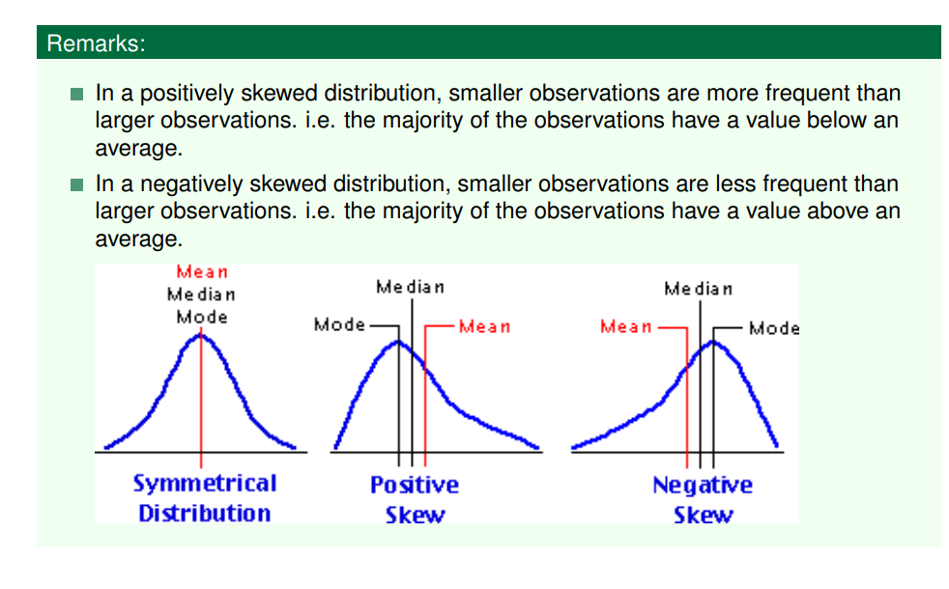
SESSION DESCRIPTION
Skewness and Kurtosis

Slide 55
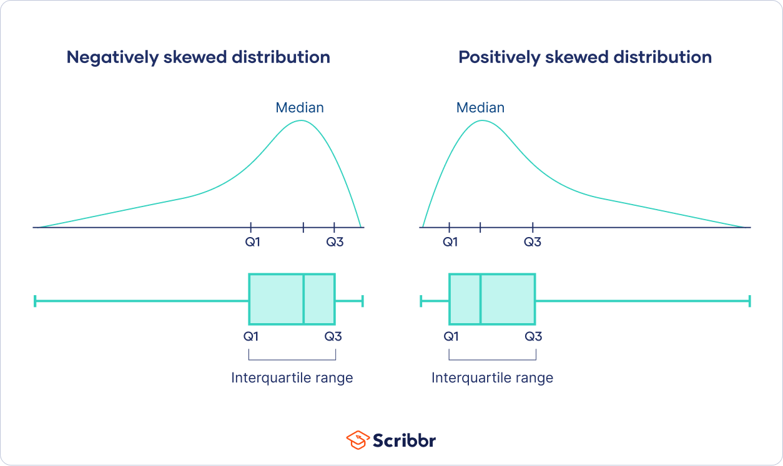
SESSION DESCRIPTION (Cont..)
Skewness
Skewness
The distance between quartiles can give you a hint about whether a distribution is skewed or symmetrical. It’s easiest to use a boxplot to look at the distances between quartiles:

Slide 56
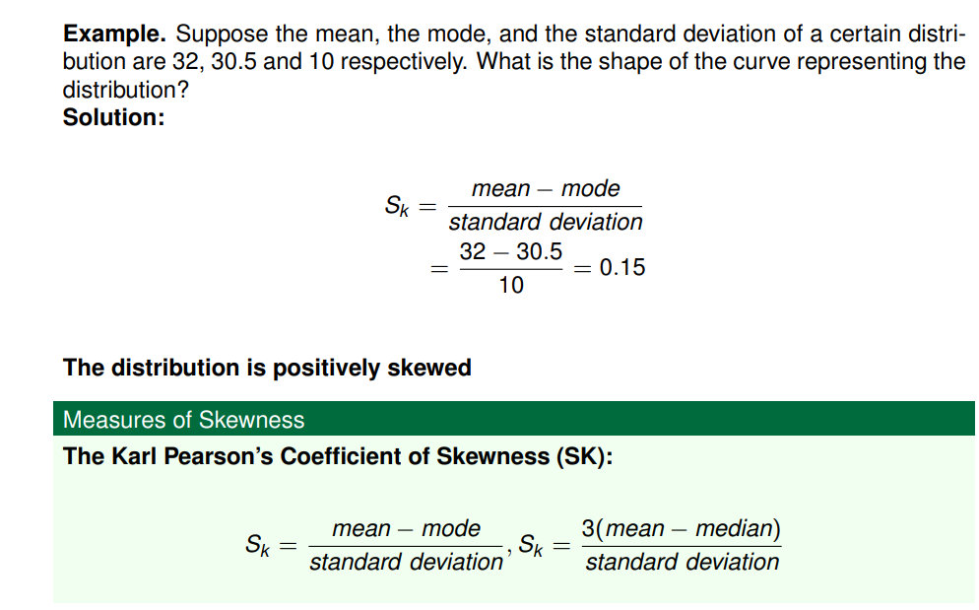
skewness
SESSION DESCRIPTION (Cont..)

Slide 57
skewness
SESSION DESCRIPTION (Cont..)
If SK = 0, then the distribution is symmetrical.
If SK > 0, then the distribution is positively skewed.
If SK < 0, then the distribution is negatively skewed

Slide 58
SESSION DESCRIPTION (Cont..)
Kurtosis
Kurtosis is the degree of peakedness of a distribution, usually taken relative to a
normal distribution.
When the curve of a distribution is relatively:
flatter than normal it is known as platykurtic and
the distribution is more peaked than normal, it is called leptokuric.
The normal distribution which is not very high peaked or flat topped is called
mesokurtic

Slide 59
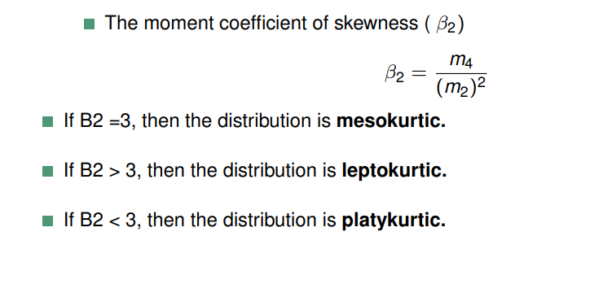
Kurtosis
SESSION DESCRIPTION (Cont..)
Distributions with medium kurtosis (medium tails) are mesokurtic.
Distributions with low kurtosis (thin tails) are platykurtic.
Distributions with high kurtosis (fat tails) are leptokurtic.

Slide 60
SESSION DESCRIPTION (Cont..)
What is a mesokurtic distribution?
A mesokurtic distribution is medium-tailed, so outliers are neither highly frequent, nor highly infrequent.
Mesokurtic distribution example
On a female baby elephant weighs an impressive 210 lbs at birth. Suppose that a zoologist is interested in the distribution of elephant birth weights, so she contacts zoos and sanctuaries around the world and asks them to share their data. She collects birth weight data for 400 female baby elephants:

Slide 61
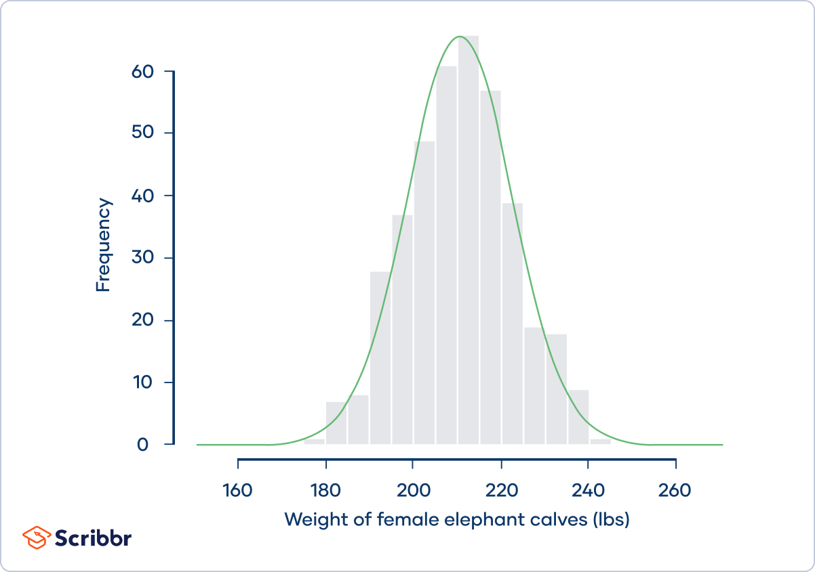
SESSION DESCRIPTION (Cont..)
Kurtosis

Slide 62
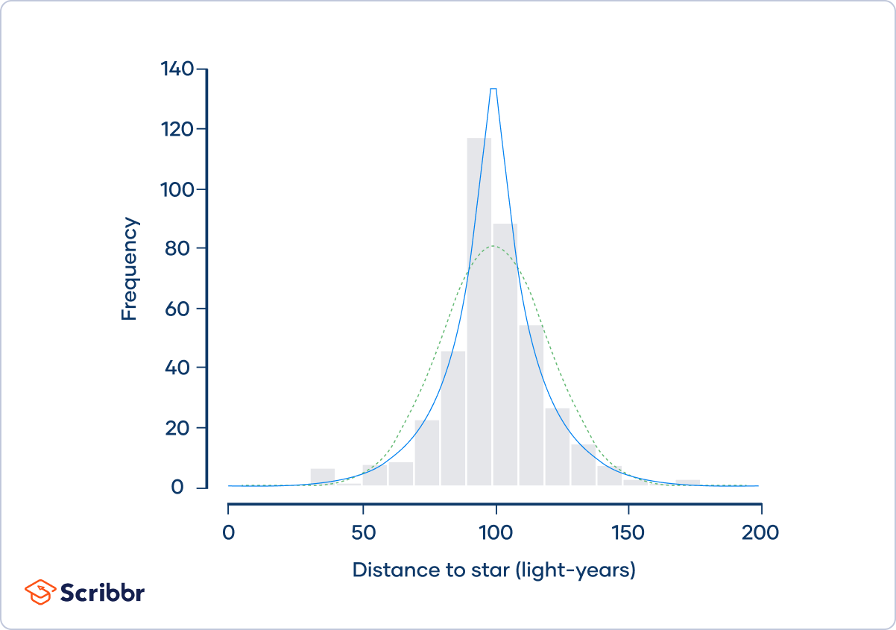
SESSION DESCRIPTION (Cont..)
What is a leptokurtic distribution?
A leptokurtic distribution is fat-tailed, meaning that there are a lot of outliers.
Leptokurtic distribution example
Imagine that four astronomers are all trying to measure the distance between the Earth and Nu2 Draconis A, a blue star that’s part of the Draco constellation. Each of the four astronomers measures the distance 100 times, and they put their data together in the same dataset

Slide 63
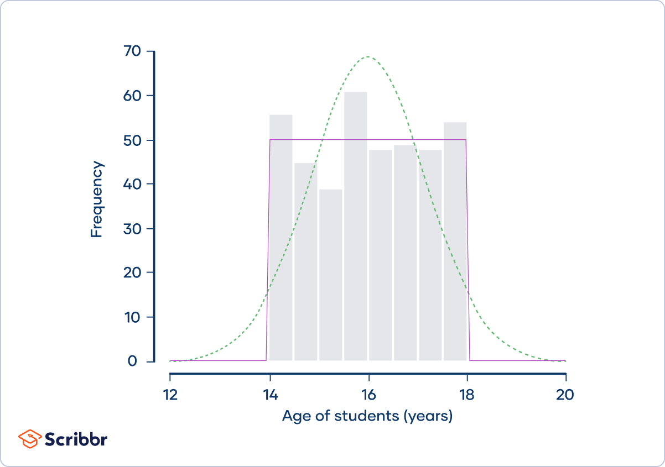
SESSION DESCRIPTION (Cont..)
Platykurtic distribution
What is a platykurtic distribution?
A platykurtic distribution is thin-tailed, meaning that outliers are infrequent.
Platykurtic distribution example
A sociologist is studying the social media use of students at a small high school. There are 400 students at the school, ranging in age from 14 to 18 years old:

Slide 64
SELF-ASSESSMENT QUESTIONS
Kurtosis is a measure of:
_________
a) Symmetry in a dataset
b) The spread or variability of data
c) The peakedness or flatness of a distribution
d) The central tendency of data
If a dataset has a skewness value of -0.5, it is:
:____________
a) Negatively skewed
b) Positively skewed
c) Symmetric
d) Normally distributed

Slide 65
TERMINAL QUESTIONS
Define skewness and explain how it measures the asymmetry of a dataset.
Discuss the factors that lead to skewness in data. Provide examples of real-world situations where skewness may naturally occur.
Elaborate on the three types of skewness: positive skew, negative skew, and zero skew. How does each type affect the shape of a distribution and the relationships between the mean, median, and mode?
Define kurtosis and its role in characterizing the shape of data distributions. Discuss how kurtosis relates to the distribution's peakedness and tail behavior.
Compare mesokurtic, leptokurtic, and platykurtic distributions. Use numerical examples to illustrate the differences in their kurtosis values and describe their characteristics.

Slide 66
REFERENCES FOR FURTHER LEARNING OF THE SESSION
Reference Books:
1. . Han J & Kamber M, “Data Mining: Concepts and Techniques”, Third Edition, Elsevier, 2011.
2. Anahory, Murray, “Data Warehousing in the Real World”, Pearson Education, 2008.
3. M.Humphires, M.Hawkins, M.Dy,“Data Warehousing: Architecture and Implementation”, Pearson Education, 2009.
Sites and Web links:
1. https://www.youtube.com/watch?v=G4NYQox4n2g&ab_channel=nptelhrd
2.https://www.youtube.com/watch?v=maKj5ovDfg&list=PL97D13C16B8A3C304
&ab_channel=nptelhrd

Slide 67
THANK YOU
Team – DWDM

